Slide 1
EBooks
Only for “E_ADEPT_REQUEST_EXPIRED”

Slide 2
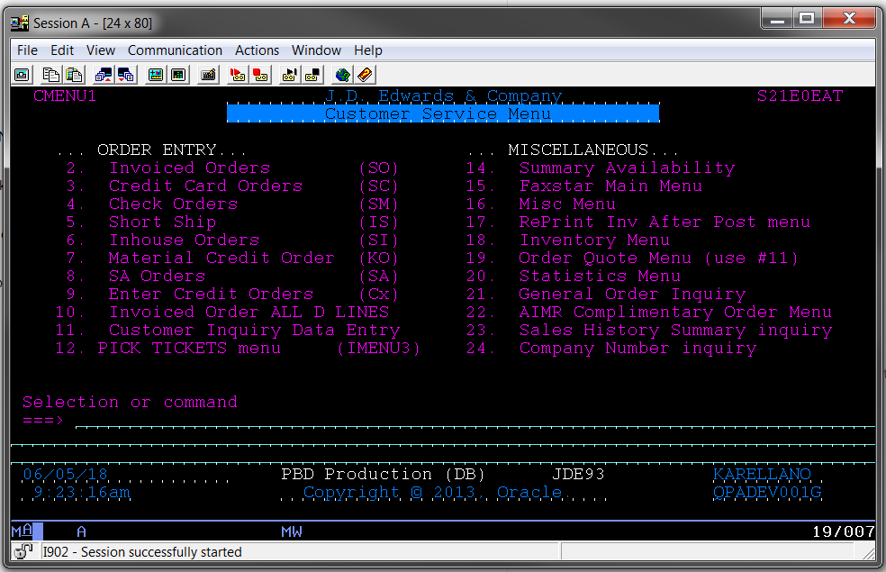
1. Open Oracle (Production)/Easy Access

Slide 3
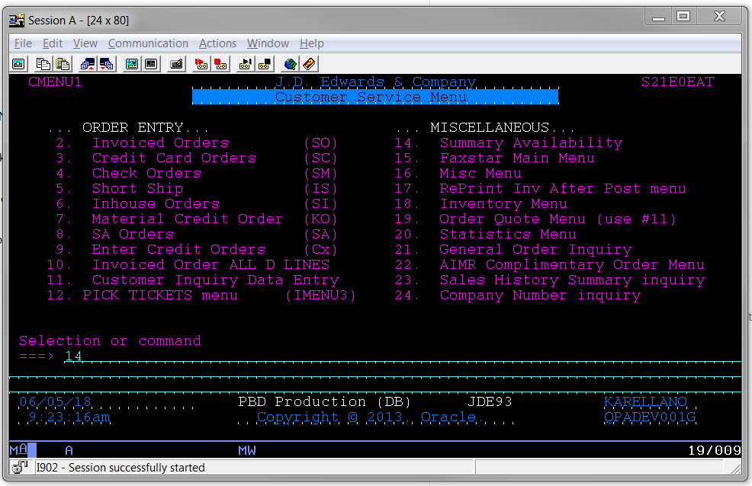
2. Type 14 in the Selection or command area and press ENTER.

Slide 4
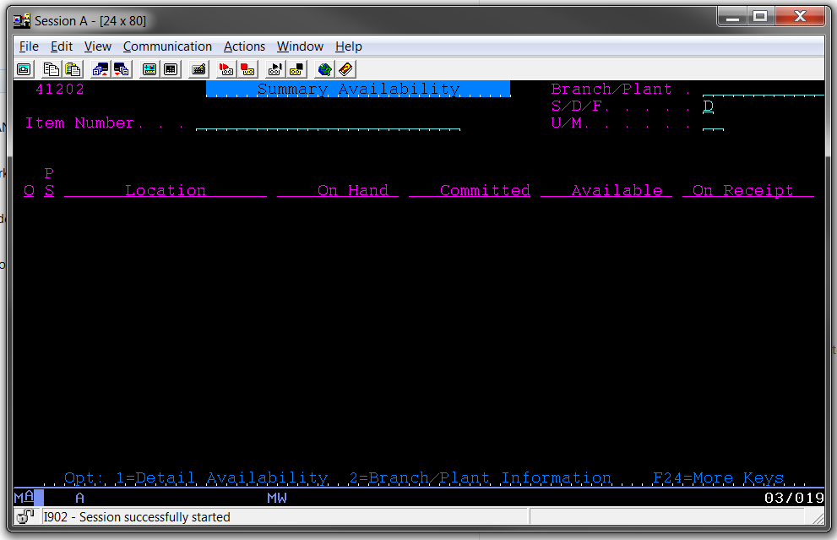
3. Type the Item Number in requested field and press ENTER.

Slide 5
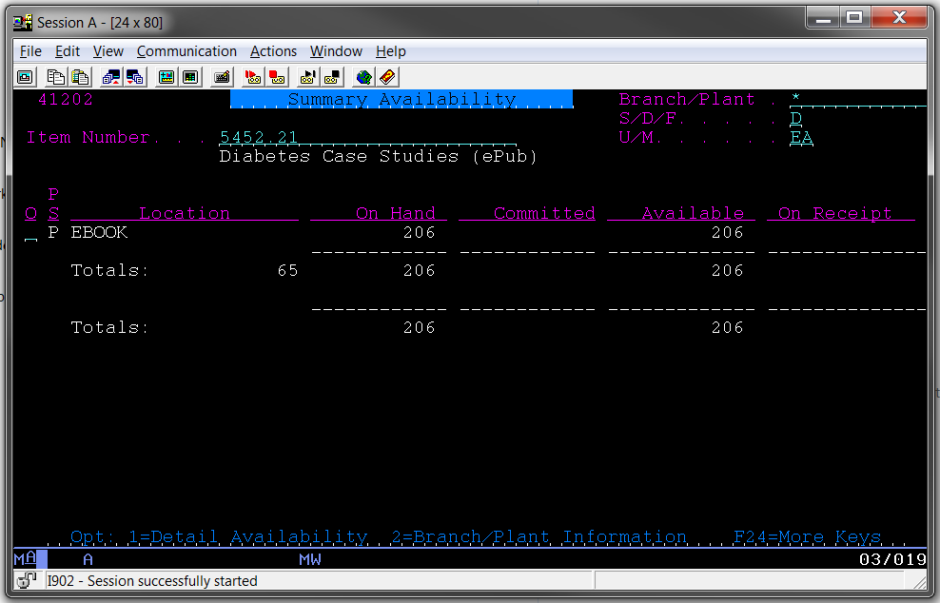
4. Jot down number of Available and click F3 to exit.

Slide 6
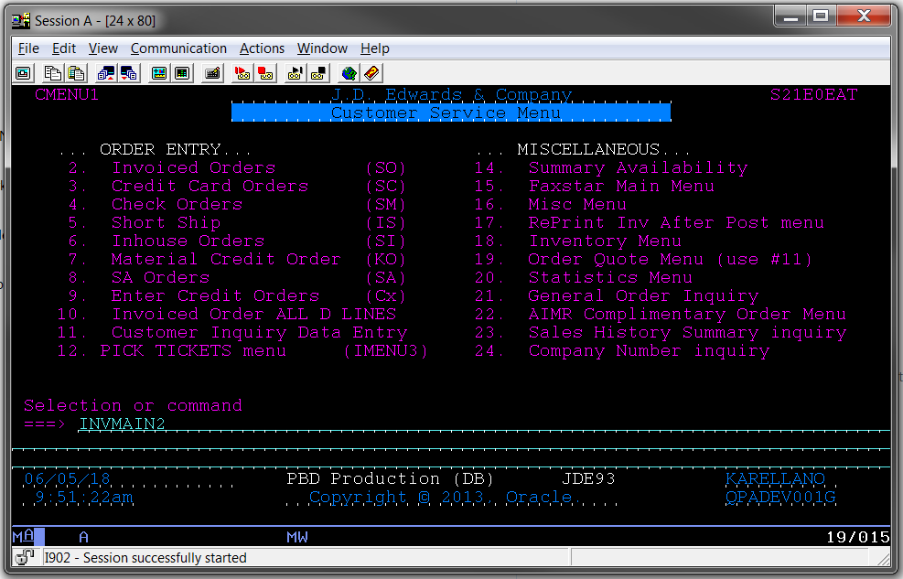
5. Type INVMAIN2 and press ENTER to request links.

Slide 7
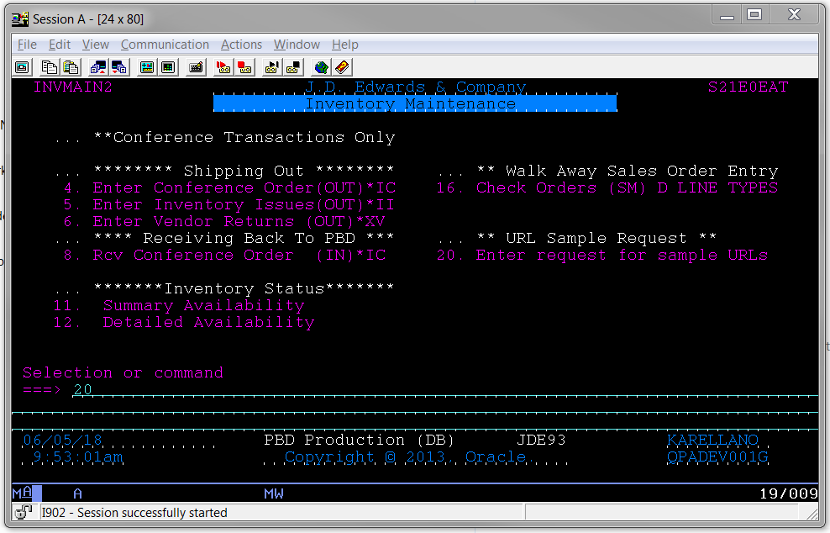
6. Type 20 and press ENTER.

Slide 8
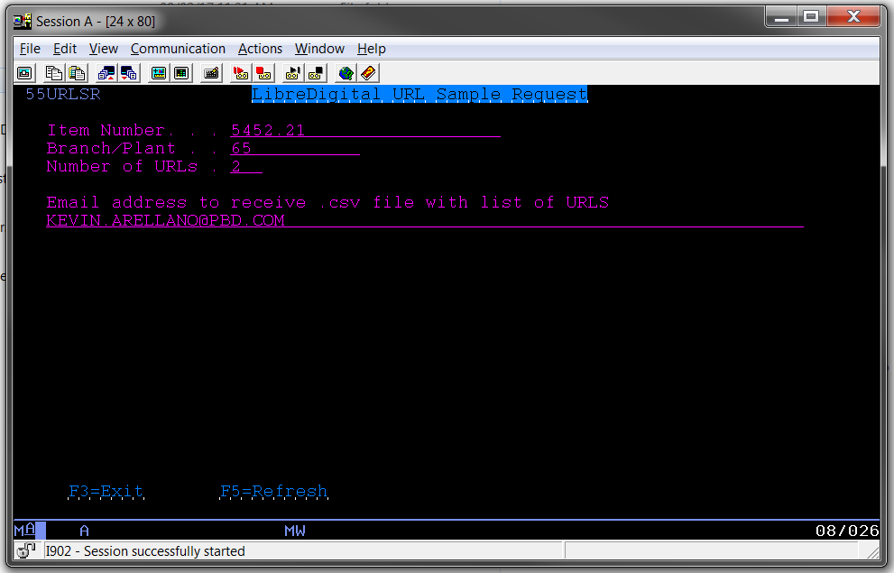
7. Fill out all of the corresponding data (Which will be found in the ticket).

Slide 9
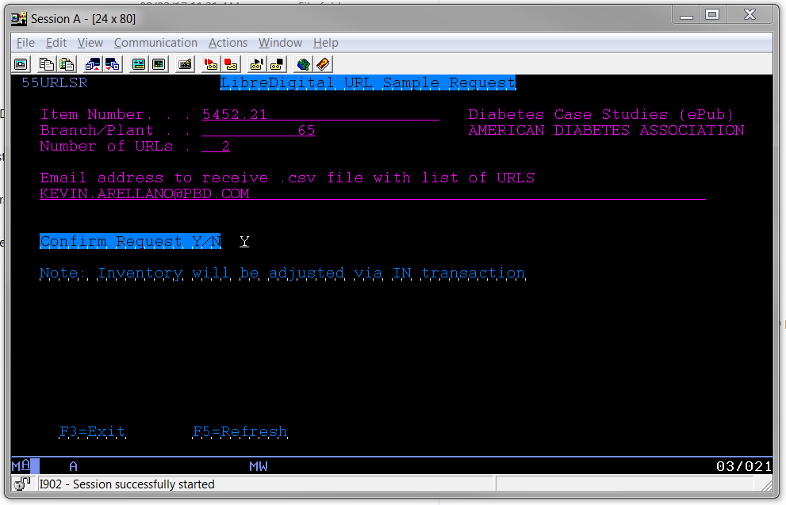
8. Press ENTER, type Y and then ENTER to confirm.

Slide 10
Data Update
Everytime this process is done, point number 4 is update.
To purge completely, the number of URLs should be the same number of links available.
Once available is 0, you may now proceed to request new links.

Slide 11
9. Press F3 to exit, and ENTER to go to the main menu.

Slide 12

10. Type BEYONDPRT and press ENTER.

Slide 13
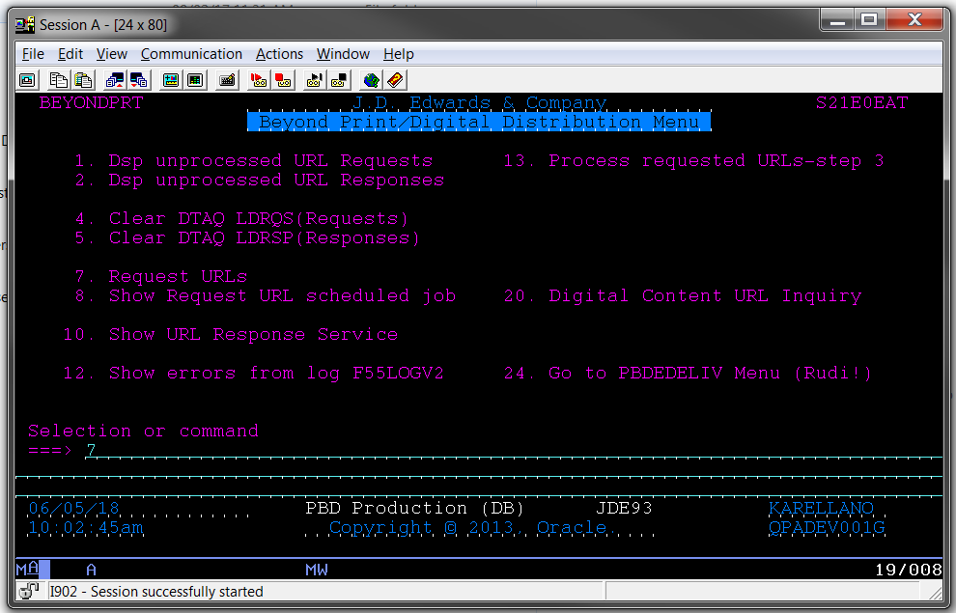
11. Type 7 and press ENTER.

Slide 14
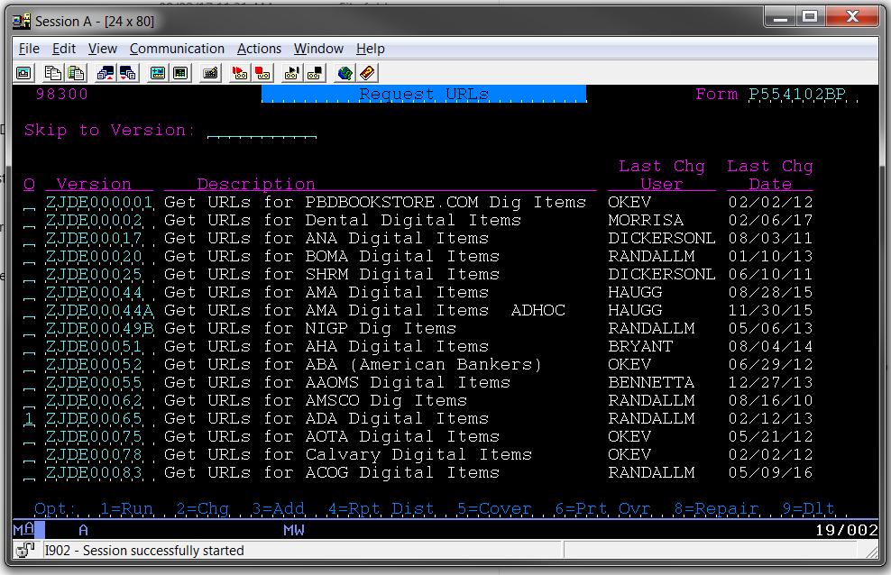
12. Find Account (Press PageDown for more), type a 1 next to and press ENTER.

Slide 15
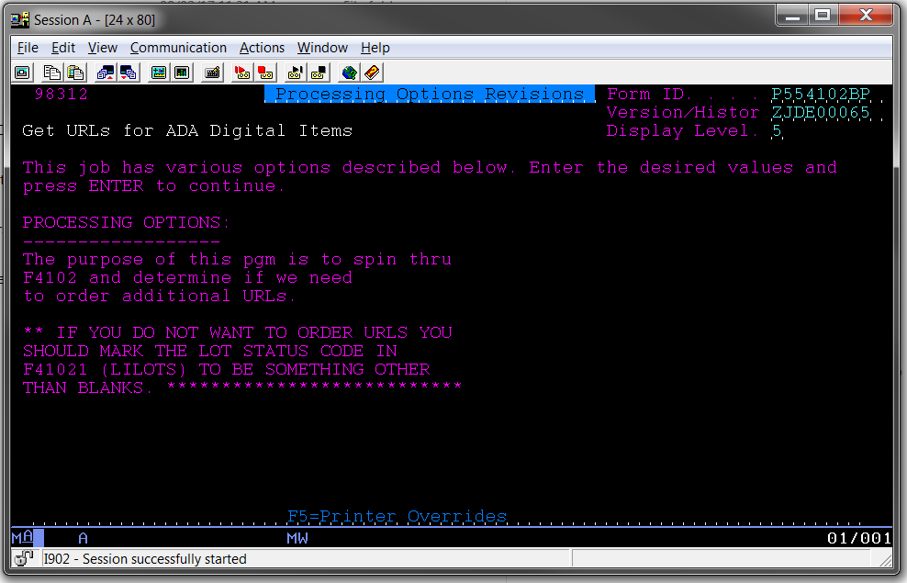
13. Press ENTER to confirm.

Slide 16
Data Update
Repeat point 12 and 13 at least 3 times to insure it was registered.
Update ticket of process and time spent.

